Slide 1
How to Login MySQL Server?
Instructor: Dr. Lee Tzong-Yi (李宗夷)
Email: leetzongyi@nycu.edu.tw

Slide 2
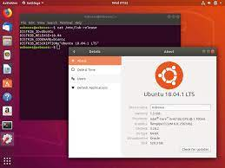

What is a server?
Computers in TC301
（Linux server）
Your computer
（Windows or Mac）
Remote control
A server is a computer or system that provides resources, data, services, or programs to other computers, known as clients, over a network. In theory, whenever computers share resources with client machines they are considered servers. There are many types of servers, including web servers, mail servers, and virtual servers.

Slide 3
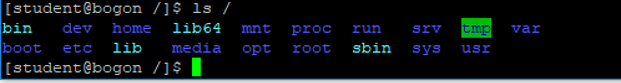
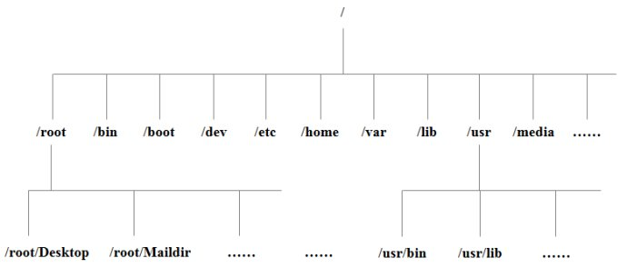
How to work on Linux OS?
Tree-like structure:
For Linux Beginners: https://www.lifewire.com/beginners-guide-to-linux-4090233
Linux Reference Manual (in Chinese): http://www.runoob.com/linux/linux-tutorial.html

Slide 4
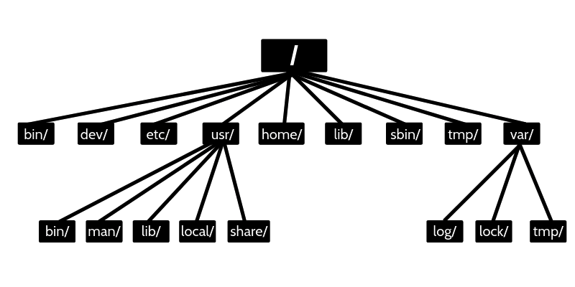
Linux file system structure: directory tree
The higher directory
The lower directory

Slide 5
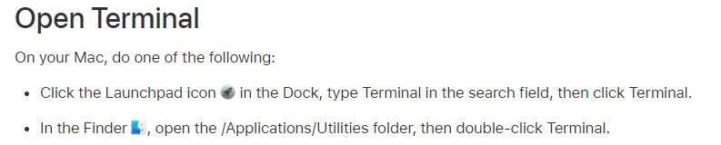
Terminal
Mac
Windows
Download putty
https://www.chiark.greenend.org.uk/~sgtatham/putty/latest.html
Input “WIN + R” and search “cmd”

Slide 6
How to log in Linux server?
Command
ssh –p 22 account@server IP
ssh –p 22 NYCU-BiOmicsLab@140.113.118.199
pwd: biomics317@nycu

Slide 7
Download the Putty Program
Step 1: Download the putty-64bit-0.79-installer from E3 system.
Step 2: Install the putty-64bit-0.79-installer
Step 3: Execute the putty.exe program

Slide 8
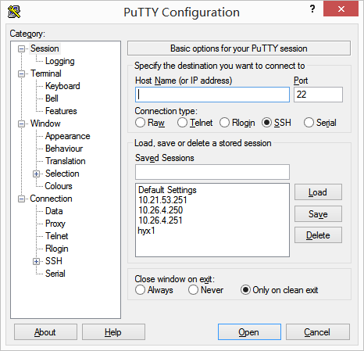
Putty visual interface
The first step:
Input server IP
The second step:
Open

Slide 9
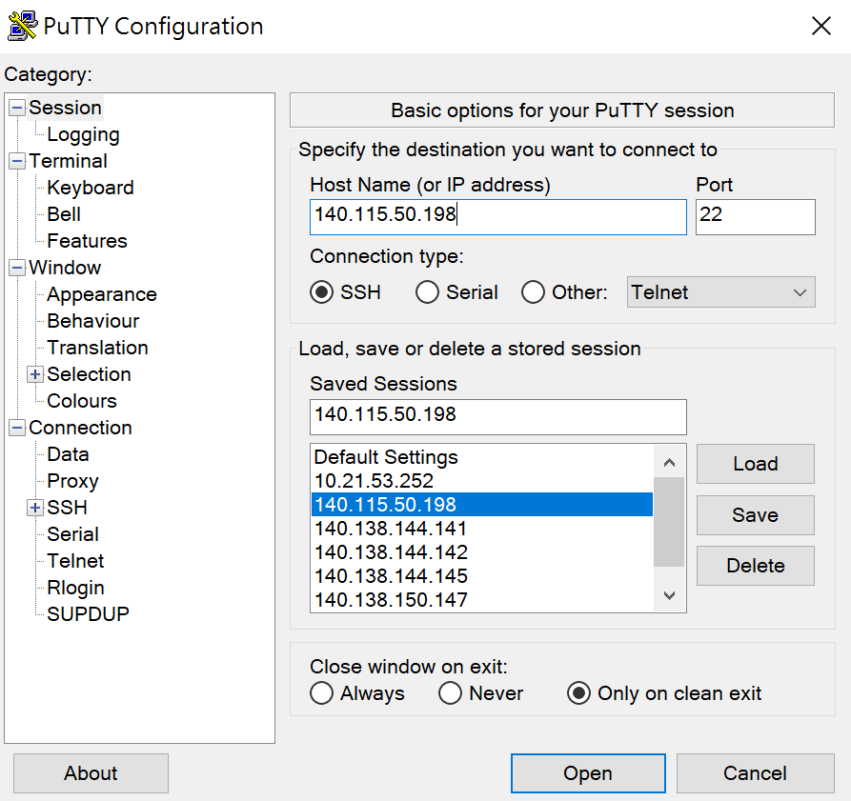
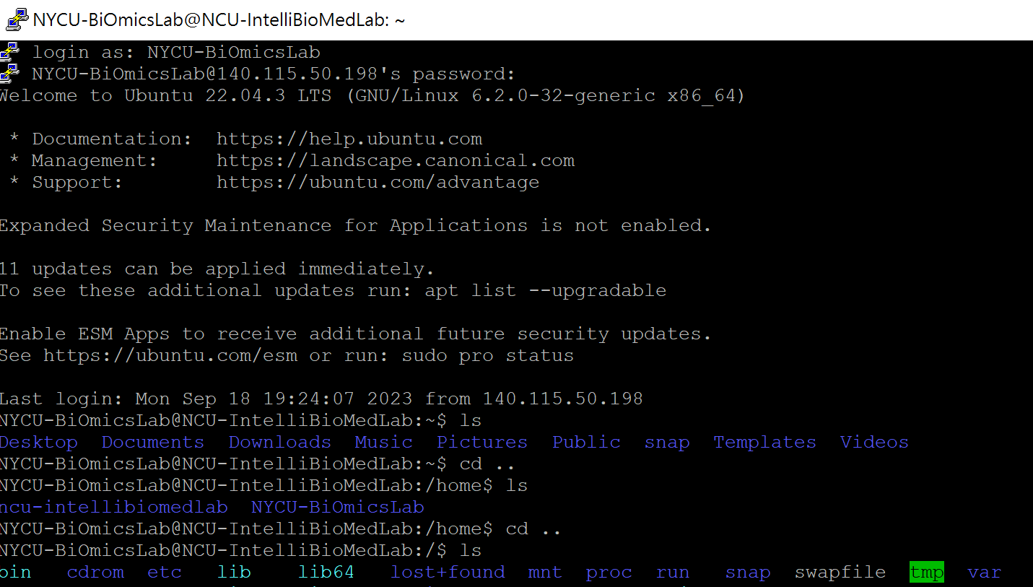
Setup the login information
Linux server IP : 140.113.118.199
Port : 22
User account/password : NYCU-BiOmicsLab / biomics317@nycu

Slide 10
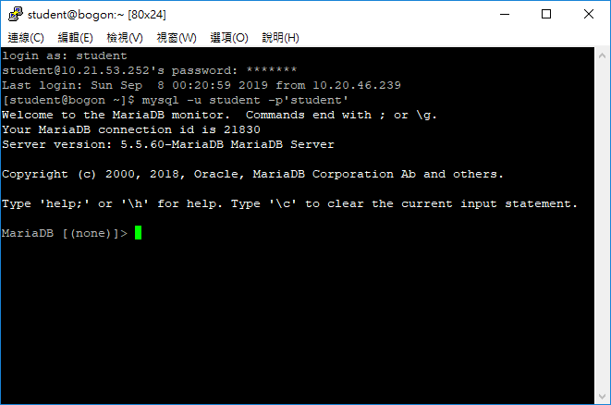
Login the MySQL DBMS
Input the mysql –u student –p’student’ in the command line to login MySQL.

Slide 11
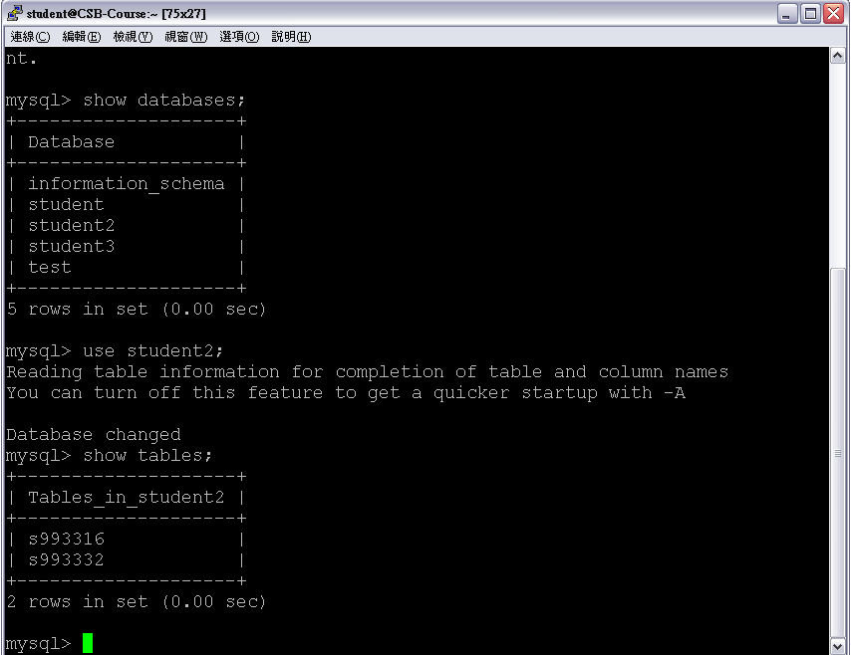
Now you can practice the SQL queries in the command line of MySQL DBMS!

Slide 12
Linux Basic Commands
pwd
print working directory
ls
used to view the contents of a directory.
cd
to navigate through the Linux files and directories. E.g., cd file, cd ..
mkdir
used to create a directory. E.g., mkdir file.
rm
to move files. E.g., rm –rf file.

Slide 13
Reference
鳥哥的 Linux 私房菜: https://linux.vbird.org/linux_basic/centos7/

